Slide 1

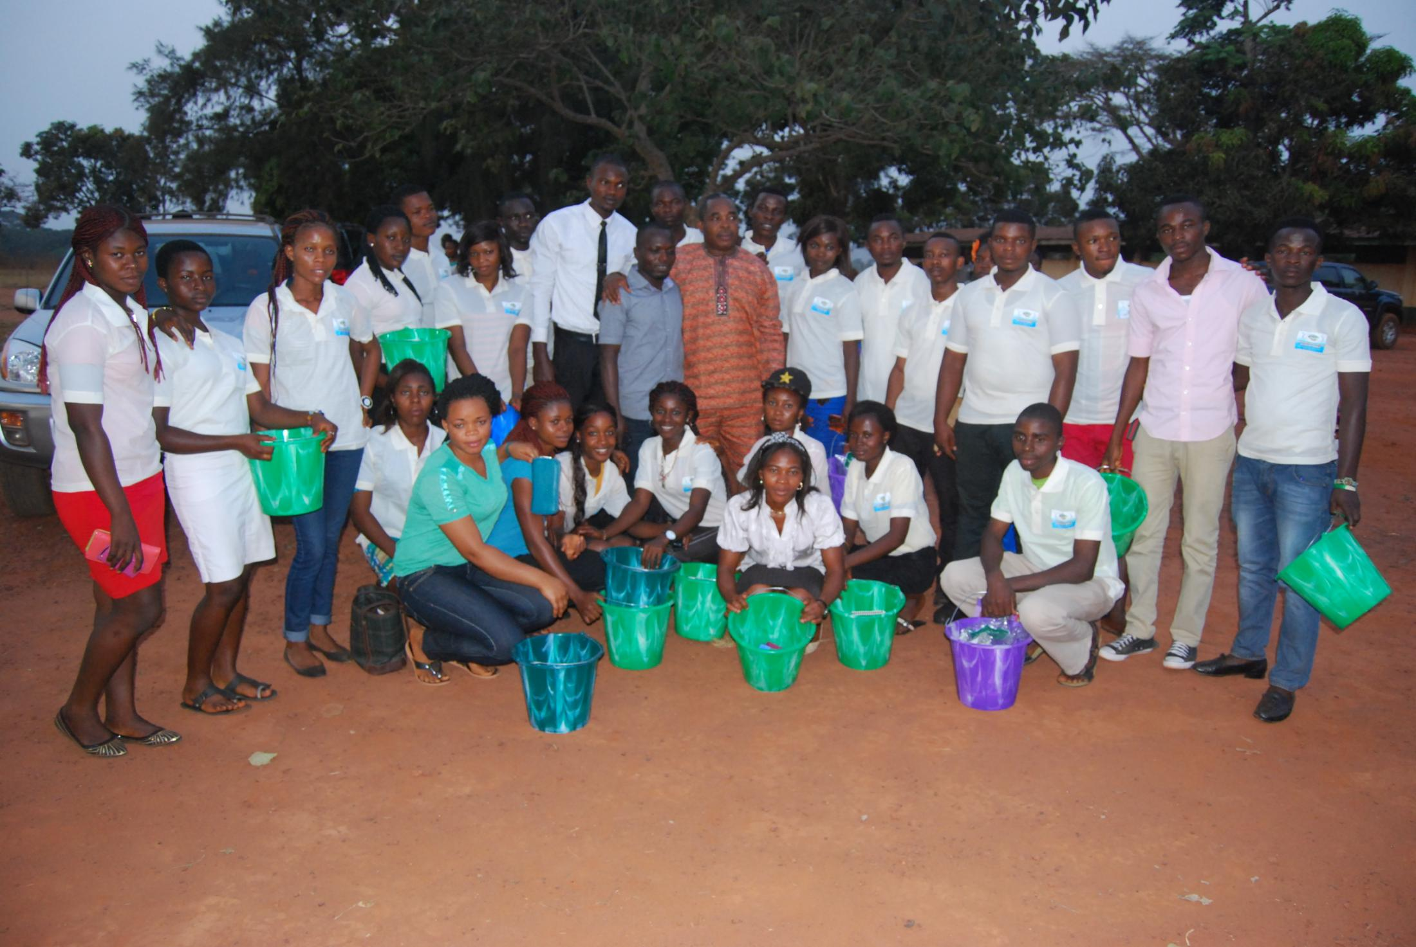
Understanding Youth Development
Domark Health and Education Foundation

Slide 2



Introduction to youth development
Development
Impacting Youth
Mentorship
Professional development
setting goals
Domark Health and Education Foundation

Slide 3
Introduction
Domark Health and Education Foundation
The United Nations classifies youth as anyone between the ages of 15 and 24.
At the age of 25, one is technically considered to be an adult.
Anyone under the age of 15 is considered to be a child.
An individual’s youth is an exciting time. It’s a time of possibilities and potential, where young people define who they are and the values they uphold.
During this time, youth are faced with significant life events and pivotal decisions. How well they navigate this stage of life, depends on the people and influences in their life.

Slide 4
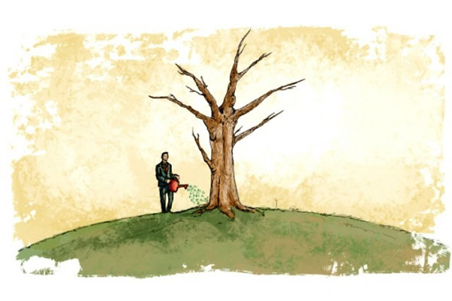
Domark Health and Education Foundation
By investing in our youth, we’re investing in the future decision makers of our communities, cultures, and countries.

Slide 5

Domark Health and Education Foundation
To become the most effective leaders of tomorrow, our youth need effective leaders today. They need mentors, entrepreneurs, coaches, and role models to guide them in their personal and professional development.
They need you.

Slide 6


Factors that Impact Youth
Domark Health and Education Foundation
All youth will have individual factors that affect their individual development and how they perceive themselves and the world around them.
For the majority of youth, there are several factors that impact how they navigate through this stage of life.

Slide 7
1. Physical Development
Domark Health and Education Foundation
As youths’ bodies undergo puberty, they’ll have to balance new hormones, changes in their bodies, and physical appearances.
While this physical development is all normal and natural, it can have both physical and psychological effects.
For e.g they can display Youthful Exuberance- a stage where teenage boys and girls show signs of livelihood, enthusiasm, vigour, energy and possible rebellion.

Slide 8
2. Cognitive Development
Domark Health and Education Foundation
The adult brain and the youth brain are actually very different. This is because the human brain doesn’t stop developing until the age of 25, so anyone 25 years of age or older is classified as an adult. In particular, the prefrontal cortex of the brain, the part responsible for rational thought, hasn’t fully developed. So while adults think mainly with the prefrontal cortex, youth think mainly with the amygdala, the part of the brain responsible for emotions.
It means that youths are more connected to their emotions when making decisions.
Involving your emotions in decision-making isn’t necessarily a bad thing, but with youth it can present issues.
Due to this brain development stage, youth are more likely to make rash decisions, feel like their emotions are overwhelming, or act without fully thinking through the consequences of their action.

Slide 9
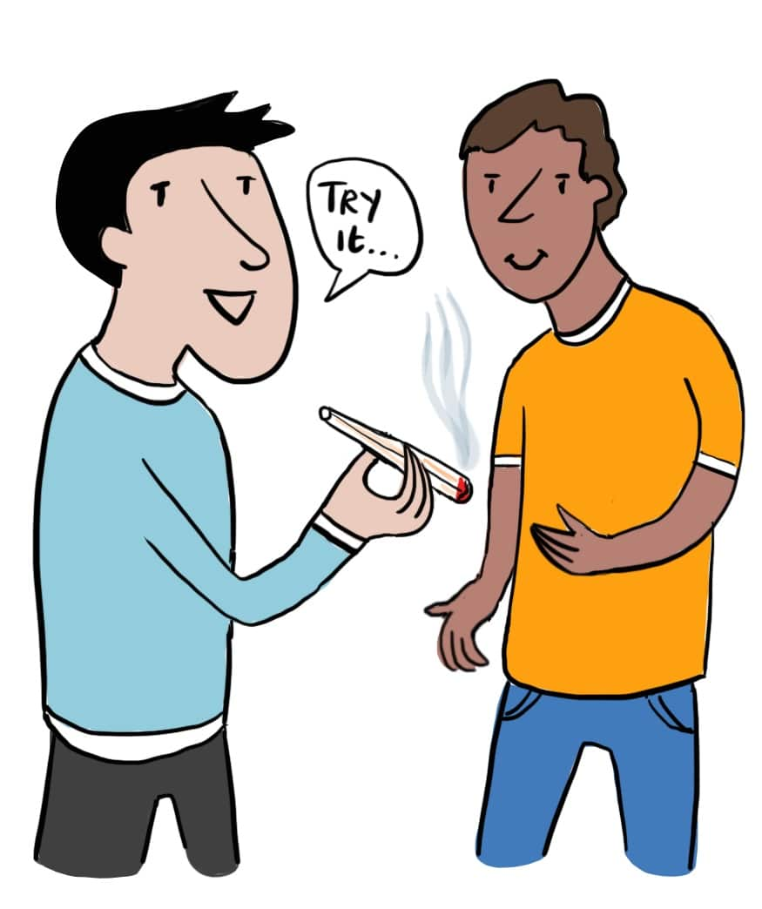
Emotional Development
Domark Health and Education Foundation
Young people tend to turn to their peers for emotional support and advice.
They may distance themselves from their parents or other adult figures
This peer pressure isn’t inherently bad, but if youth surround themselves with peers who have different values or priorities, it could have negative consequences

Slide 10

How do we impact Youth?
Domark Health and Education Foundation

Slide 11
As a youth mentor, you have the unique opportunity to impact someone at the most critical time in their lives.
Domark Health and Education Foundation
Youth need help about;
Careers,
Education
Relationships
Character

Slide 12
Youth Mentorship
Domark Health and Education Foundation
A mentor serves as a positive adult role model—someone whose character, career, or life they can aspire to emulate.
Mentoring youth can provide them with encouragement, motivation, and responsibility
This relationship can only be achieved and sustained if the mentor is a committed and caring leader.

Slide 13
Six Elements of Youth Mentorship
Domark Health and Education Foundation
1. Connection
For mentees, connection is the feeling of a positive bond with their mentor or their mentoring institution. Connection creates the feeling of safety, structure, and belonging. When connection exists in a mentorship, mentees know that they can trust and confide in their mentor.

Slide 14
Six Elements of Youth Mentorship
Domark Health and Education Foundation
2. Confidence
Confidence is a sense of self-worth and self-esteem. With youth, it’s critical for them to have a belief in themselves and their abilities. Confident youth are more likely to believe that they have the capacity to succeed, not just in their careers, but in their personal relationships with others.

Slide 15
Six Elements of Youth Mentorship
Domark Health and Education Foundation
3. Character
When it comes to young persons’ character, it’s important to focus on taking responsibility for their actions and creating a sense of independence. As they develop their own personality, they also need to develop their sense of individuality and a connection to principles and values. A youth with a strong sense of character is less likely to be swayed by peer pressure or negative influences

Slide 16
Six Elements of Youth Mentorship
Domark Health and Education Foundation
4. Caring
By building caring in youth, you’re building their capacity to care for others. The ability to feel sympathy and empathy helps connect youth to the world around them and their specific communities. With a caring attitude, youth may feel a stronger commitment to moral issues, social justice, and overall compassion to other individuals.

Slide 17

Six Elements of Youth Mentorship
Domark Health and Education Foundation
5. Contribution
Think of contribution as active participation and leadership. Contribution is an important tool for youths to apply to school, family, and extracurricular activities. As youths’ ability to contribute goes, so does the feeling that they can make a difference
in the environments around them.

Slide 18
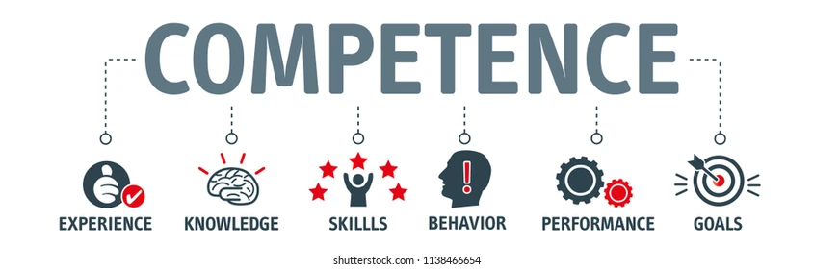
Six Elements of Youth Mentorship
Domark Health and Education Foundation
6. Competence
Competence is not necessarily how intelligent an individual is, but rather their ability to be effective in important situations. These can include social moments or moments at school or work. As youth develop competence, they’re developing their ability to engage and achieve things in their community, culture, education, employment, and social life.

Slide 19


Domark Health and Education Foundation
yali.state.gov/youth
#YALI4Youth
Youth development workbook available at link https://uploads.mwp.mprod.getusinfo.com/uploads/sites/29/2021/08/YALI4Youth-Workbook.pdf

